Slide 1
Kubernetes App Lifecycle
VishwanaTH m s

Slide 2
Agenda
Overview of Deployment
Deployment Strategies
Lab: Managing Deployment
Lab: Blue-Green Deployment Strategy

Slide 3
What is a Deployment in Kubernetes?
A Kubernetes controller that manages replica sets and ensures desired state of pods.
Automates:
  Pod creation
  Scaling
  Rollouts/Rollbacks

Slide 4
Key Deployment Features
Declarative updates
Self-healing (replaces failed pods)
Rollback capabilities
Versioned updates
Notes:
1. Declarative Updates
Speaker Notes:
In Kubernetes, deployments are declarative — meaning you describe the desired state in YAML or JSON, and Kubernetes ensures the current state matches it.
This approach removes the need for manual step-by-step commands and makes deployments repeatable, version-controlled, and easily auditable.
It’s ideal for GitOps workflows, CI/CD pipelines, and infrastructure as code.
🟢 2. Self-Healing (Replaces Failed Pods)
Speaker Notes:
Deployments ensure that the specified number of pods are always running.
If a pod crashes or a node fails, Kubernetes will automatically detect it and recreate a new pod to maintain availability.
This self-healing behavior ensures resilience and high availability without manual intervention.
🟢 3. Rollback Capabilities
Speaker Notes:
Kubernetes maintains a revision history of your deployments.
If a new version causes an issue, you can quickly roll back to the previous stable state using kubectl rollout undo.
This reduces risk in production deployments and is especially useful when paired with health checks and monitoring.
🟢 4. Versioned Updates
Speaker Notes:
Each update to a Deployment is tracked as a new revision.
This allows you to monitor changes over time and understand how your application evolved.
It also provides traceability and helps teams coordinate deployments more effectively in collaborative environments.

Slide 5
Benefits of Deployment
Easy scaling
Self-healing pods
Rollback support
Declarative and versioned

Slide 6
Rolling Update Strategy
Default in Kubernetes
Gradual replacement of old pods
Zero downtime (if configured correctly)
maxUnavailable, maxSurge
Default Values:
strategy:
type: RollingUpdate
rollingUpdate:
maxSurge: 25%
maxUnavailable: 25%

Slide 7
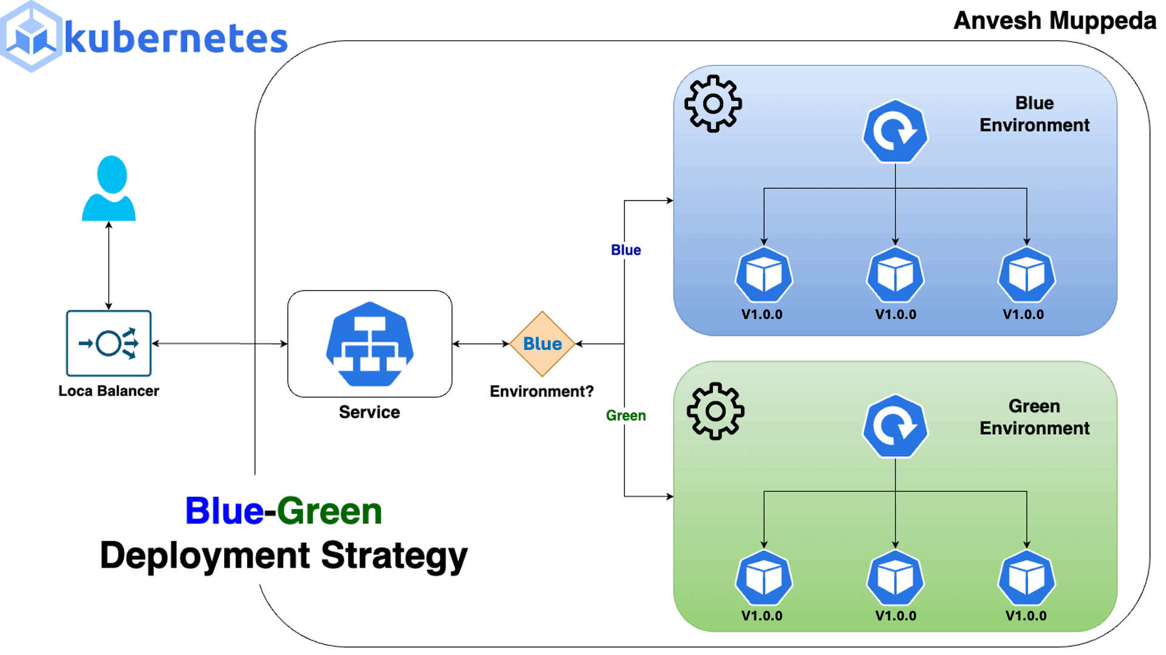
Kubernetes DaemonSet

Slide 8
Recreate Strategy
All old pods terminated, then new ones created
Downtime expected
Use-case: incompatible app versions or DB migrations

Slide 9
Blue-Green Deployment
Two environments: Blue (live), Green (new)
Traffic switch via Service object
Benefits: instant rollback, zero downtime
Tools: kubectl, Argo Rollouts, custom scripts

